Slide 1

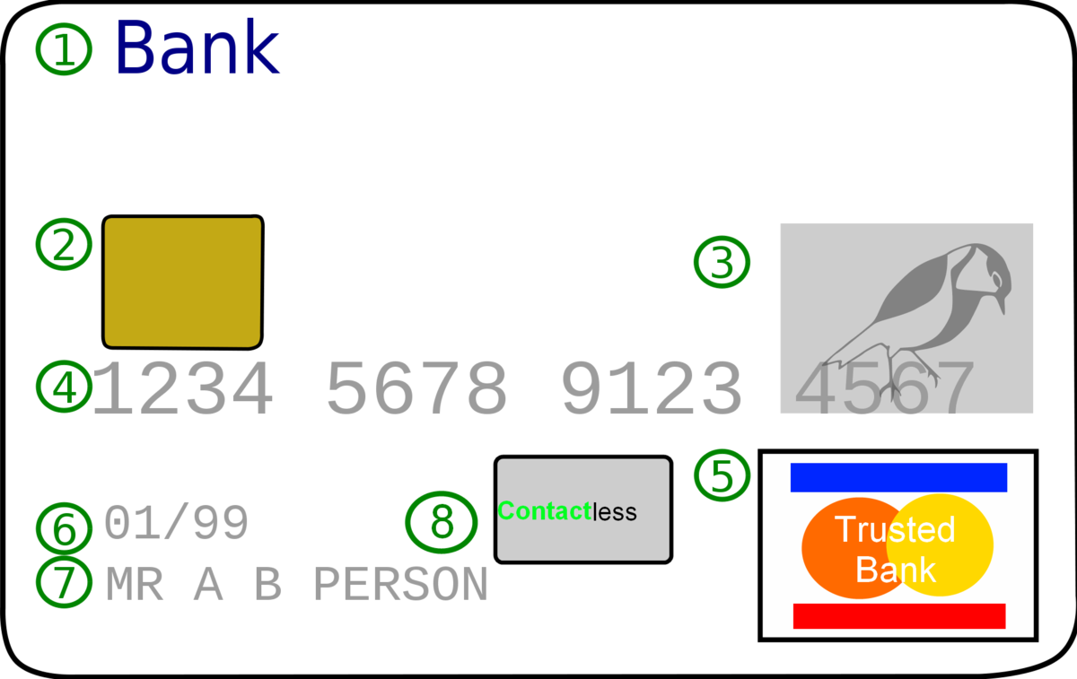
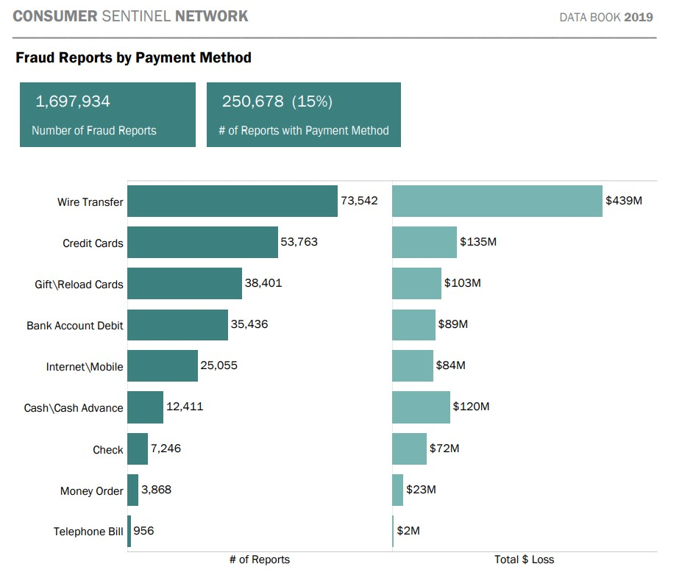
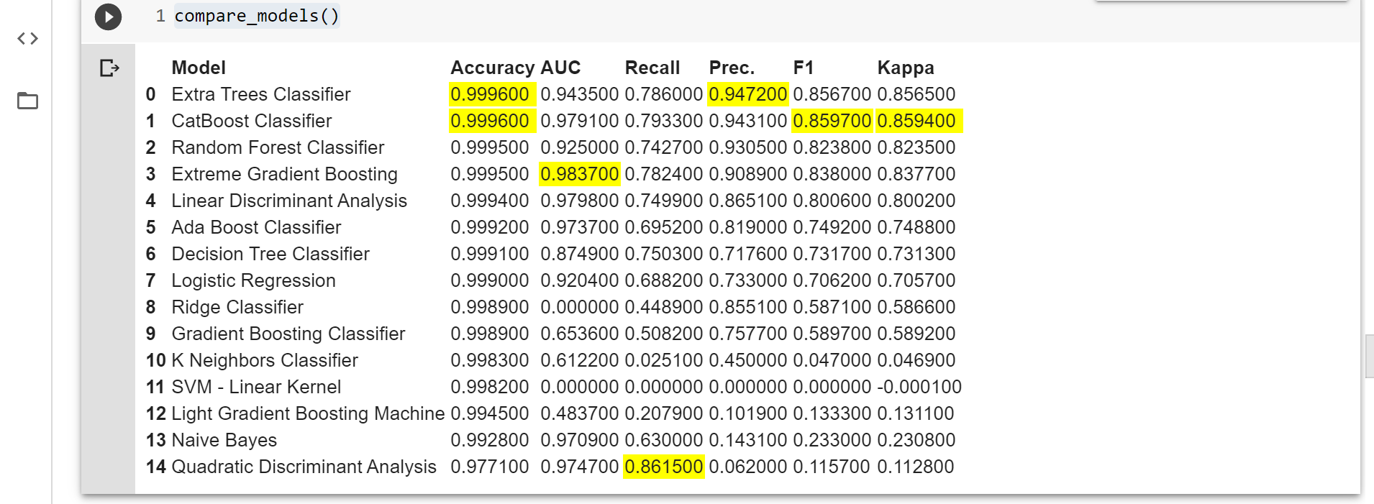
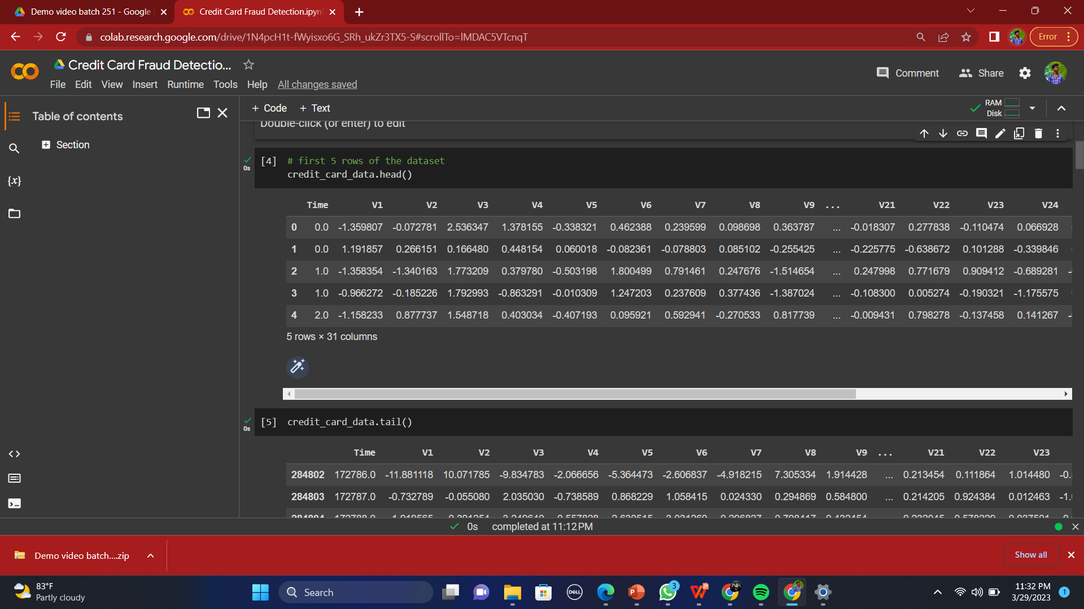
“Fraud credit card detection using machine learning’’
Department of Computer Science & Engineering
School of Computing
1156CS601 – MINOR PROJECT
WINTER SEMESTER 2022-2023
ABSTRACT
INTRODUCTION
RESULTS
STANDARDS AND POLICIES
Credit card fraud detection is presently the most frequently occurring problem in the present world.This is due to the rise in both online transactions and e-commerce platforms.Credit card fraud generally happens when the card was stolen for any of the unauthorized purposes or even when the fraudster uses the credit card information for his use. In the present world, we are facing a lot of credit card problems. To detect the fraudulent activities the credit card fraud detection system was introduced.
This project aims to focus mainly on machine learning algorithms. The algorithms used are random forest algorithm ,linear regression , XGBoost ,KNearest, Support vector classifier, Linear Discriminant Analysis, GaussianNB algorithm.
Credit card fraud detection is presently the most frequently occurring problem in the present world.
This is due to the rise in both online transactions and e-commerce platforms.
Credit card fraud generally happens when the card was stolen for any of the unauthorized purposes or even when the fraudster uses the credit card information for his use.
In the present world, we are facing a lot of credit card problems. To detect the fraudulent activities the credit card fraud detection system was introduced.
This project aims to focus mainly on machine learning algorithms. The algorithms used are random forest algorithm ,linear regression , XGBoost ,KNearest, Support vector classifier, Linear Discriminant Analysis, GaussianNB algorithm. The results of the algorithms are based on accuracy, precision, recall, and F1-score.
These are a type of lock that keeps online transaction safe from any digital attack.
The digital attack can take place in many ways but to attack the fraudster need a to find loop hole through which they can get the access once they found the hole the account will have slightly suspicious behavior that is sent to the next software that is security information and event management system software now IRP (interim resolution professional)
Stage 1. Data gathering .
Early data analysis techniques were orientedextracting quantitative and statistical data characteristics this technique facilitate useful data interpretations and can help to get better insights into the processes behind the data.
The number indication 1 shows that it is a fraud transaction and 0 indicates the non-fraud transactions
Stage 2. Exploratory Data analysis
Exploratory Data Analysis refers to the critical process of performing initial investigations on data so as to discover patterns,to spot anomalies,to test hypothesis and to check assumptions with the help of summary statistics and graphical representations.
.
A fraudulent card transaction is an unauthorised transaction that is carried out with your credit card. The thief either physically steals your credit card, or steals your card information via phishing or credit card skimming and uses it to make payments, or withdraw cash.This decision often considers the location of the transaction (IP address, geolocation, device identification), source of the transaction (internet, ATM etc.),
TEAM MEMBER DETAILS
Figure 1.
Figure 2. .
CONCLUSIONS
<Student 1. vtu15337/Nalluri Karthik>
<Student 2 .vtu17056/Cheella Balaji>
<Student 3 .vtu18313/K.Lokesh>
<Student 1. Ph no 9353354620>
<Student 2. Ph no 9177376654>
<Student 3. Ph no 8978859193>
<Student 1. vtu15337@veltech.edu.in>
<Student 2. vtu17056@veltech.edu.in>
<Student 3. vtu18313@veltech.edu.in>
METHODOLOGIES
Machine learning algorithms are used for credit card fraud detection. The power
of machine learning is used to detect credit cards frauds and the performance of different machine learning algorithms is compared. Three machine learning algorithms, Decision Tree, XGBoost , Linear regression, KNearest , Support vector classifier ,etc are applied on a data set have the data of 284808 credit cards. The performance of XGBoost, KNearest and logistic regression algorithms are found
accuracy of 93% percent.
System development method is a process through which a product will get
completed or a product gets rid from any problem. Software development process is
described as a number of phases, procedures and steps that gives the complete software. It follows series of steps which is used for product progress.
Using Sliding-Window method, we aggregate the transactions into respective groups, i.e., extract some features
from window to find cardholder's behavioural patterns. Features like maximum amount, minimum amount of
transaction, followed by the average amount in the window and even the time elapsed
ACKNOWLEDGEMENT
Project Supervisor Ms.K.ALAMELU
Project supervisor Contact No +91 8883834163
Project supervisor Mail ID kalamelu@veltech.edu.in

